Slide 1
Mutual Fund Analytics Platform
Capstone Project | Bluestock Fintech Pvt. Ltd.
Presented By: Ayushi Jaiswal
Role: Data Analyst Intern
Technologies Used: Python • SQL • SQLite • Power BI • Pandas

Slide 2
Project Objective
Objective
Develop an end-to-end mutual fund analytics platform to:
Analyze mutual fund performance
Track investor behavior
Evaluate risk and returns
Generate actionable investment insights
Build interactive dashboards for decision-making
Business Goal
Help investors and analysts make data-driven investment decisions.

Slide 3
Data Sources
Data Sources Used
AMFI india
MFAPI
Benchmark index data
Investor transaction data
Portfolio holdings data
Datasets
Dataset | Purpose
Fund Master | Fund metadata
NAV History | Historical NAV analysis
AUM Data | Asset growth analysis
SIP Inflows | Investment trends
Investor Transactions | Investor behavior
Benchmark Data | Performance comparison
Portfolio Holdings | Concentration analysis

Slide 4
Project Architecture
Tools
Data Collection
Data Cleaning
EDA
SQLite Database
Performance Analytics
Advanced Analytics
Power BI Dashboard
Python
Pandas
Numpy
SQLite
Jupyter Notebook
Power BI

Slide 5
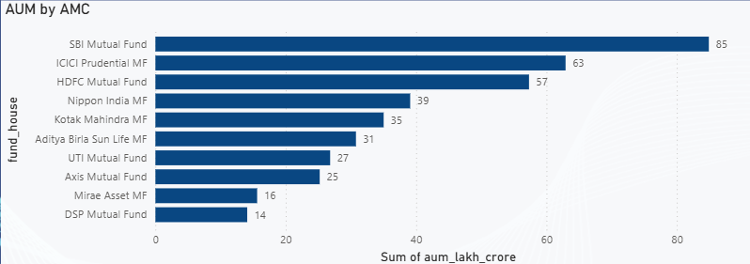
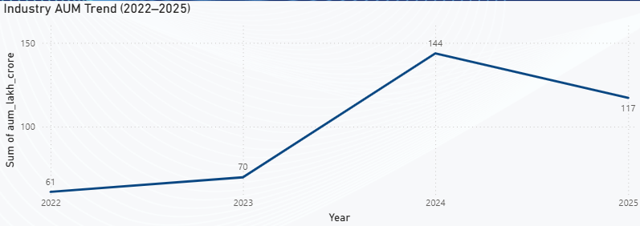
Exploratory Data Analysis
Key Analyses -
Industry AUM trends
SIP growth analysis
Fund category distribution
Investor demographics
State-wise transactions
Outcomes -
Identified major fund categories
Observed transaction trends
Analyzed investor participation

Slide 6
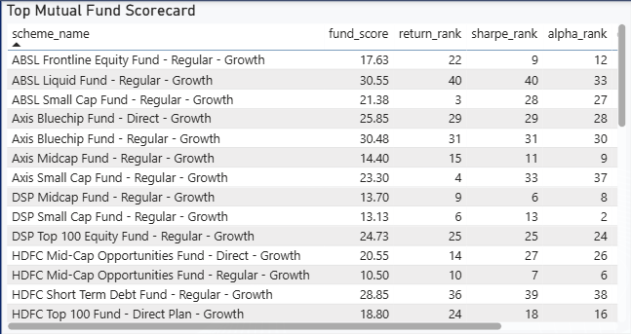
Fund Performance Analytics
Metrics Computed
Cagr
Sharpe ratio
Sortino ratio
Alpha
Beta
Tracking error
Maximum drawdown

Slide 7
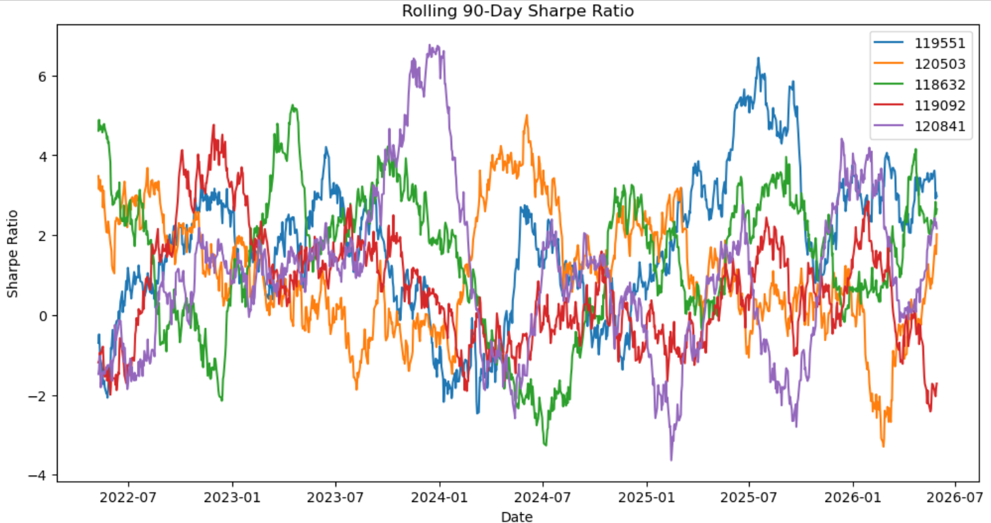
Advanced Analytics
Implemented Models
Historical var (95%)
Conditional var (cvar)
Rolling 90-day sharpe ratio
Investor cohort analysis
SIP continuity analysis
Fund recommendation
engine
Sector HHI concentration
analysis

Slide 8
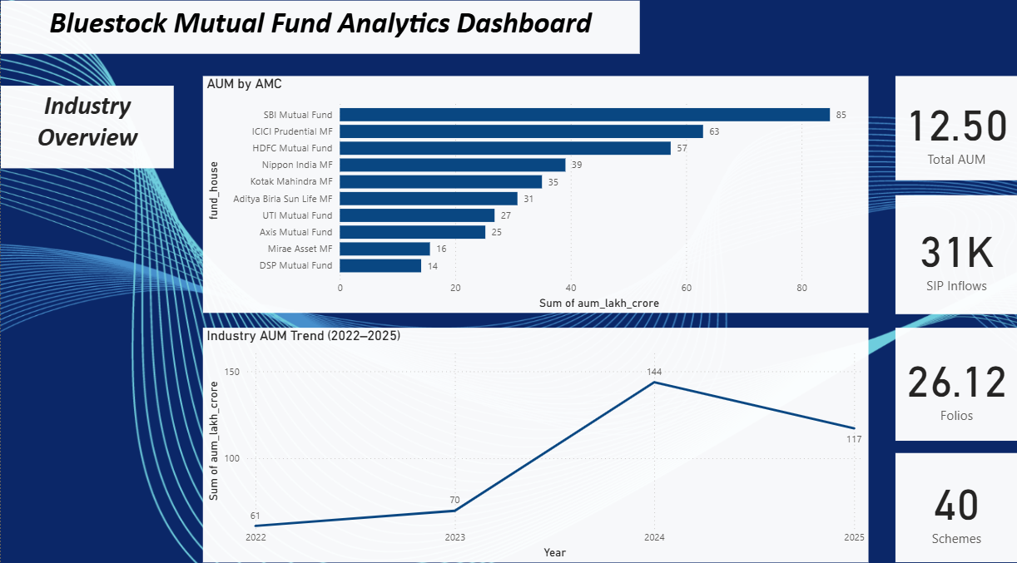
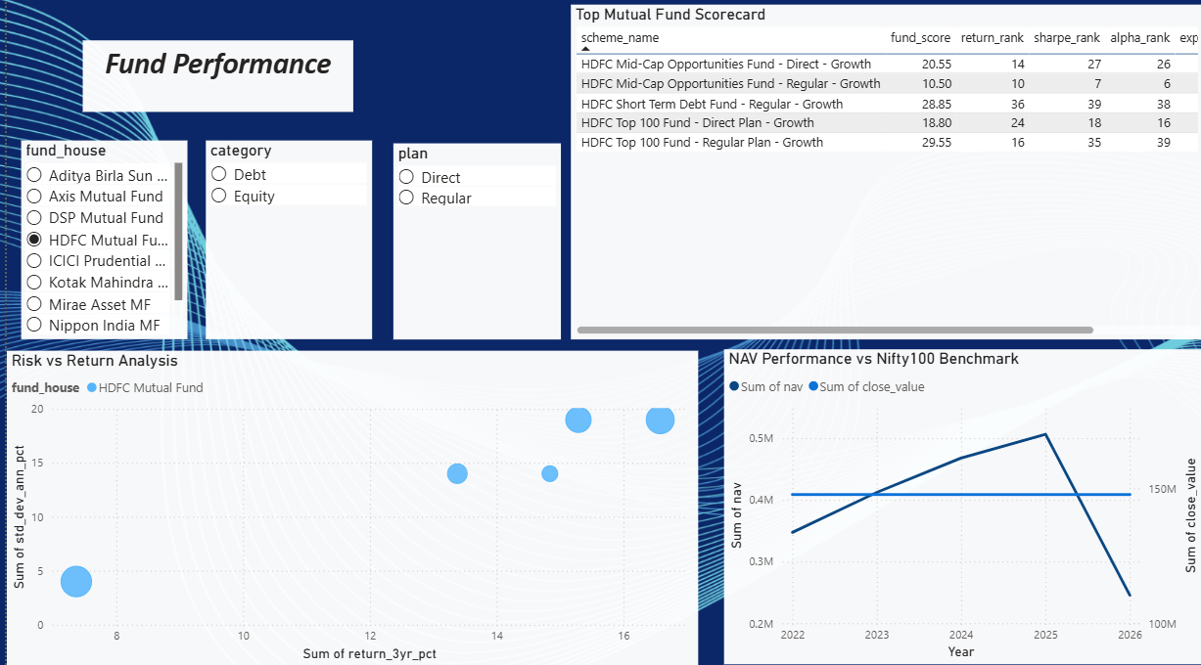
Power BI Dashboard
Fund Performance
Risk vs Return Analysis
Fund Scorecard
NAV vs Benchmark
Industry Overview
Total AUM
SIP Inflows
Folios
AUM by AMC

Slide 9
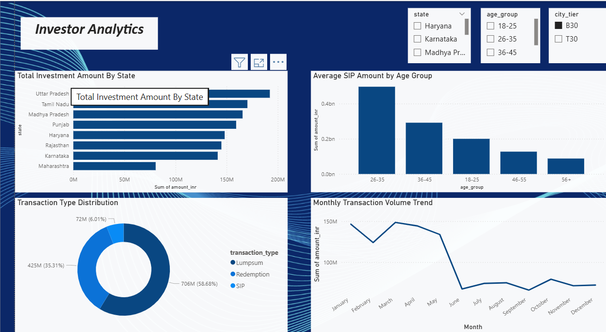
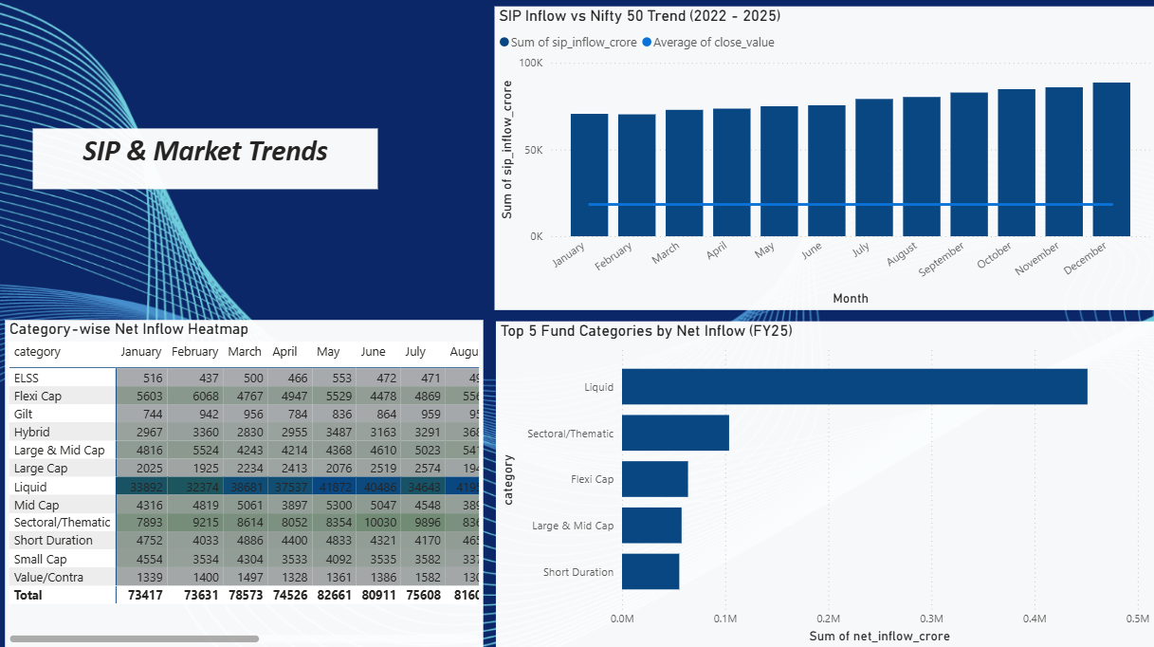
Investor Analytics
State-wise Transactions
Investor Demographics
SIP Behavior
SIP & Market Trends
SIP vs Nifty Trends
Category Inflows

Slide 10
Key Business Insights
1. Downside Risk Assessment
Fund 119599 exhibited the highest downside risk, recording the lowest var (95%) and cvar values among all analyzed schemes, making it more vulnerable during adverse market conditions.
2. Investor Cohort Performance
The 2024 investor cohort emerged as the most valuable segment, contributing over ₹349 crore in investments across 4,803 investors, significantly outperforming newer cohorts.
3. SIP Continuity Risk
SIP continuity analysis identified 1,332 investors as at-risk, with average contribution gaps exceeding 35 days, indicating potential SIP discontinuation and investor churn.
4. Portfolio Diversification
Sector concentration analysis showed that 25 out of 34 funds maintained low concentration levels, indicating strong diversification and reduced sector-specific risk exposure.
5. Risk-Adjusted Fund Selection
Sharpe ratio analysis revealed substantial differences in risk-adjusted returns across funds, demonstrating that higher returns do not always translate into better investment efficiency.

Slide 11
Business Recommendations
Recommendations
Improve SIP retention through automated reminders
Promote diversified funds to reduce concentration risk
Use risk-based fund recommendation models
Monitor high-risk funds proactively
Leverage cohort insights for targeted marketing

Slide 12
Project Deliverables
Deliverables Generated
Mutual fund analytics database
EDA reports
Performance analytics reports
Advanced analytics notebook
Power BI dashboard
Recommendation engine
Github repository
GitHub:
Mutual Fund Analytics Platform Repository

Slide 13
Conclusion
Project Summary
Successfully developed an end-to-end mutual fund analytics platform that integrates:
Data collection & processing
Extract, Transform, Load (ETL)
Exploratory data analysis (EDA)
Financial performance analytics
Risk modeling & advanced analytics
Investor behavior analysis
Fund recommendation engine
Interactive power BI dashboard

Slide 14
Key Achievements
Analyzed 40 mutual fund schemes using multiple performance and risk metrics.
Built interactive dashboards for fund performance, investor analytics, and market trends.
Developed advanced analytics models including var, cvar, rolling sharpe ratio, sip continuity analysis, and sector concentration analysis.
Generated actionable insights to support data-driven investment decisions.
Closing Statement
The project demonstrates how data analytics, risk modeling, and business intelligence can be combined to transform raw mutual fund data into meaningful investment insights.

Slide 15
Thank you

